Slide 1

Exploratory Data Analysis-3
Complete EDA Pipeline
Today’s Agenda
Data Cleaning & Preprocessing
Feature Understanding & Relationships
Outlier Detection & Handling
Feature Engineering Techniques
Summary & Preparing for Modeling
Hands-On Practice
Kahoot(Quiz)

Slide 2
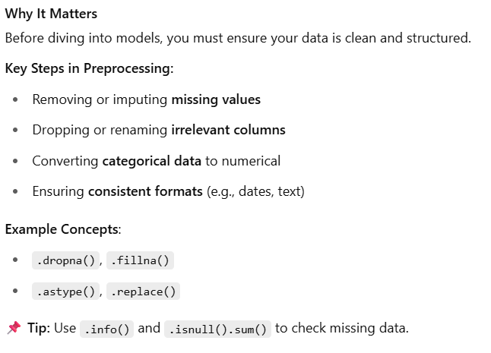
Data Cleaning & Preprocessing

Slide 3
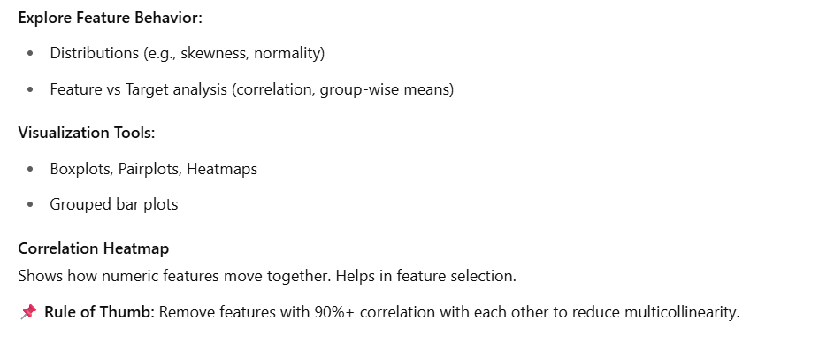
Feature Understanding & Relationships

Slide 4
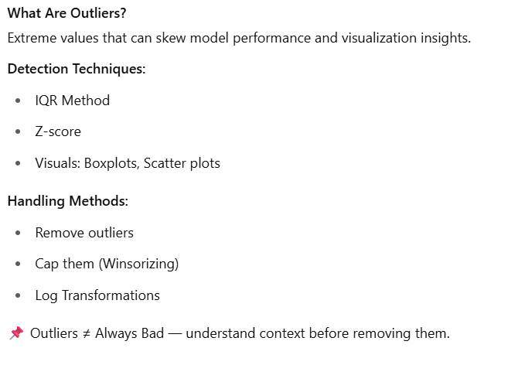
Outlier Detection & Handling

Slide 5
Short break

Slide 6
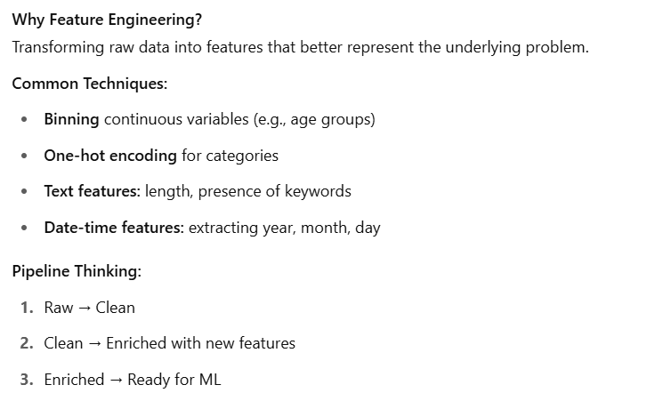
Feature Engineering Techniques

Slide 7
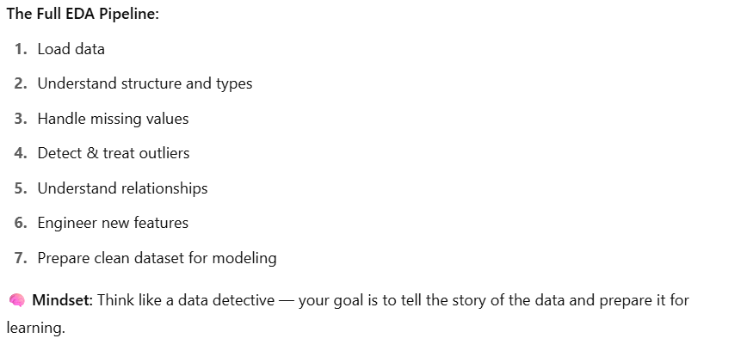
EDA Summary & Pipeline Wrap-up

Slide 8
Main Break

